Slide 1
GEM
Automate Your Database Infrastructure
By Ed Barlow
www.edbarlow.com
barlowedward@hotmail.com

Slide 2
What Is GEM
short for “Generic Enterprise Manager”
  Tool Set For Sybase & Sql Server Dba’s
  Proactive Server Management
  Open source perl
  Based on 20 years of database shareware
  Designed by and written for DBA’s

Slide 3
What GEM Does
Ensure Your Backups Work
Configuration Auditing
Enterprise Reporting
End User Approval Of System Access
Monitoring and Alarming
Best Practices Automation
DBA Process Automation

Slide 4
What GEM Really Is
Big Set of Perl Scripts
Built around common library api
Integrated Database
Web User Interface
GEM Generates a customized set of batch scripts

Slide 5
The solution for dba’s
GEM automates dbms management
Targeted @ 25+ Data Servers
Solves Real World Problems
Open source scripts
  Simple architecture
  Inexpensive
  No sales pitch

Slide 6
Current Solutions
Scripts
  individually designed and maintained
Incomplete View on your Systems
Expensive & Complex Vendor Tools
All this leads to Business Risks
You can miss stuff allowing preventable problems to occur

Slide 7
GEM is Low Risk
Simple centralized architecture
  No agents. Easy setup. Easy removal.
Open source perl
  You can see exactly what it does
Uses common best practices
Low Risk to Try It Out

Slide 8
GEM Introduction
Target Market
  Mid Sized Enterprises
  10-300 Databases
High functionality
Designed for and by DBAs

Slide 9
GEM Design Notes
Windows, Linux, and UNIX
Centralized information collection
  Monitoring Information
  Basic Configuration Management Db
  Credentials information mapped to LDAP
  Historical performance information
  Configuration Audits – Internal & For Auditors
Email Interface
  Email Alerts of problems
  Over alerting == proactive management

Slide 10
GEM Target Market
You have professional dba staff
Many databases
Remote systems
You want centrallized reporting to help manage your enterprise

Slide 11
GEM Design Notes
Simplicity – GEM is many simple self documenting command line programs
Open API – common perl libraries
  Extensible to solve your specific problems
  Add your own heartbeats
Simple directory structure

Slide 12
The GEM Philosophy
report on problems but do not auto-fix them. GEM provides information about problems but does not fix them. That’s your job!
Occams Razor – simple is best

Slide 13
Sample Company #1
All Windows Environment
  Centralized monitoring
    Your windows databases
    Your windows systems
  Complements the Microsoft tools
  Server Auditing

Slide 14
Sample Company #2
Linux / Unix / Sybase / Mysql
  Centralized monitoring
    Sybase & Mysql databases
    Unix systems
  Provide Essential Tools
    Backup and log shipping solution
    New system Stored procedures
  Server Auditing

Slide 15
Sample Company #3
Mixed Unix and Windows
  All the benefits of both environments
  Single common administration interface
    All code works on both windows & unix
  Installed on samba share
    unix monitoring station
      No password ssh access
    windows monitoring station
      native wmi access as administrator

Slide 16
Components of GEM
GEM Console: The web interface
  Credential Reporting
  Auditing
  Alerting/Alarming
  Configuration Reporting
GEM Main Programs
  configure.pl – the installer
  gem.pl – post install tasks

Slide 17
Components of GEM
GEM Batch Scripts
  custom generated scripts to monitor & report
Stored Procs for Sybase and Sql Server
  Widely used freeware that expands the system stored procedures like sp_who (sp__who)
GEM Monitoring Database
GEM Utilities
  extensive set of command line utilities
Sybase & Sql Server Backup Scripts
  flexible plan based set of command line server maintenance scripts. (released separately as freeware – for Sybase & Sql 2000)

Slide 18
GEM Installer
GEM works on configuration files
  hand editable
  Stored in the conf subdirectory
    password files (*.dat)
    monitor specific files (*.dat)
    configure.cfg: maintenance plans
Define web server locations, perl version, database connection parameters
Once set up – it just works

Slide 19
GEM Batch Scripts
Customized based on configuration files
Integrated with windows scheduler on your windows monitor system
Sample crontab files created on unix monitor system

Slide 20
Stored Procedure Library
Sybase & Sql Server
Extends the system stored procedures
  significantly more usable
  sp__ (2 underscores) instead of sp_
  Many common procedures
90 New Stored Procedures
New Formatting, Additional Features

Slide 21
Server Maintenance Scripts
  Sybase and Sql Server
  Command line based
  Based on Maintenance Plans
  Reorgs, Statistics, Audits, Dbcc, Backups, Log Shipping
  For Sybase or Sql 2000 only.
    We recommend native mirroring or native log shipping for 2005/2008 servers. The tools work with that and add value
    Can still run on the command line

Slide 22
Server Maintenance Scripts
  Separately Documented Free Package
  Configuration auditing
  Integrated with GEM alarming & reporting
  Commands run from central system
  Triple check for backup verification
  Work seamlessly with native sql server tools

Slide 23
Database Utilities
  A large number of simple, easily understood, automation command line scripts.

Slide 24
GEM Perl Libraries
Alarming Library
Database Connectivity Library
Remote File Retrieval
Log File Filtering
Password & Config Management

Slide 25
GEM Coding Style
programs are self documenting
  perldoc program.pl
  Program usage summary: program.pl -?
  Main documentation built from perldoc
If a program doesn’t work
  Try -d or -–DEBUG command line args
  program.pl –DEBUG or program.pl -d

Slide 26
GEM Console (the web interface)
Configure & View Alarms
  Example: event logs, systems availability, space monitoring…
Configuration Reporting
  Allows you to proactively manage servers
Morning Review

Slide 27
GEM Console (the web interface)
  Error Logs
  Backup Logs
  Server Configuration
  Long Running Operations
  Systems & Server Reports
  Enterprise View
  Trends & Space growth details

Slide 28
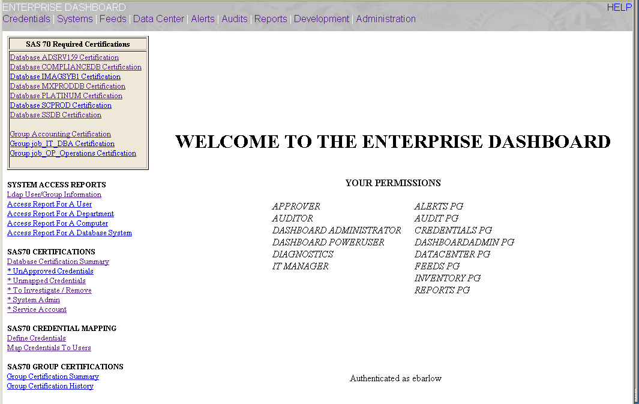
GEM Console Screenshot

Slide 29
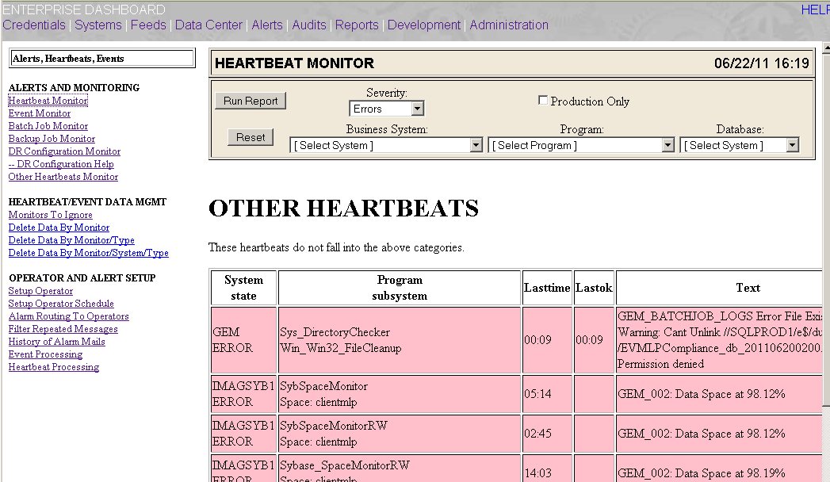
GEM Console Screenshot

Slide 30
Process: Security Audits
  Integrated With LDAP
  Process to Map Users to Database Logins
  Looks at ALL credentials
    Unix, Windows, Database, NIS, LDAP
  Sas 70 Audit Reporting - Approvals
  Enterprise security reporting

Slide 31
Process:
Configuration Audits
  Extensive Configuration Auditing
  Template based filtering
  Extracts DDL needed to rebuild servers
  Configuration Change Tracking
  Long Running Operations Tracking

Slide 32
Alarms & Monitoring
Numerous Heartbeats
  Heartbeats have state (Ok/Error/Critical)
  No Timestamp
Event Logs
  Have State AND Timestamp (ie. logfiles)
Configurable Operators & Routing

Slide 33
Alarming and Monitoring
Uses a central database
Full featured alarming library api

Slide 34
More Features
Guarantee Your Backups Succeed
Morning Review Process
Asset Management Database
Server Config/Run Book

Slide 35
Where To Start
www.edbarlow.com
Documentation @ www.edbarlow.com/gem
Read the Getting Started Guide
Contact us for a trial

Slide 36
Minimum Requirements
Central Database Server
  Sql Server if all win32 databases
  Sybase ASE - free version
  1-2 GB
Web Server
1 or 2 Dedicated monitoring systems
Perl 5.8 or later
Samba if hybrid unix / Sybase

Slide 37
Summary
Full Featured, Perl, Open Source
Designed for the working dba
Distributed as free software for 15+ years
Designed for maintainability
Satisfaction Guaranteed

Slide 38
Automation is the key to effectively manage large numbers of databases
GEM automates key DBA tasks

